Slide 1




Family context private beta Full User research report
March 2020

Slide 2
COntents
Project Context
Recap of Alpha User Research
Overview of Private Beta User Research
Private Beta User Research Findings
Next Steps

Slide 3
Project context

Slide 4

Project overview
Objective: Provide social workers with key information on what services are engaged with the child’s family in a way that works across councils
Partners: Stockport, Leeds, Social Finance and MHCLG’s Local Digital Collaboration Unit. Manchester has also participated and provided thoughts and feedback to the project team through show and tells.
Funding: MHCLG’s Local Digital Fund and the Christie Foundation – both funders are focused on supporting local authorities to create common solutions to shared problems

Slide 5
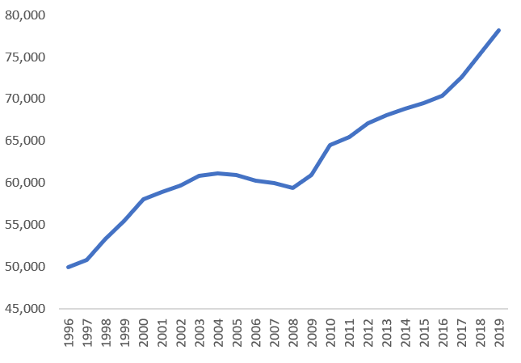
The social issue
The increase in numbers of children in care
The number of children taken into care in England has reached a 25-year high
Children who experience the care system are some of the most disadvantaged in the country, with significantly lower outcomes in comparison to their peers. They are:
4x more likely to be involved in the Youth Justice system than their peers
5x more likely to face exclusion from school than their peers
40x more likely to become homeless than their peers
Number of children in care
Year

Slide 6

The problem
When social workers first interact with a family, they do not have easy access to key information. This includes the services that family members engage with. The consequences of this are:
Social workers sometimes have incomplete information which can change decisions and outcomes.
Social workers waste time chasing information, which they would prefer to spend with the family.

Slide 7
Why solve the problem?
We want to ensure that social workers always have the information they need so that:
More young people are well looked after by their families and fewer end up in care
Children are protected from harm even when no single service perceives significant risk
Social workers are viewed by all families as people who really understand their circumstances and can support them

Slide 8
The solution: Family Context
Family Context is a tool that allows social workers to easily access service involvement information on relevant individuals to a child. It facilitates conversations with lead practitioners from other services, so that social workers can better support families and safeguard children.

Slide 9
Timeline and key milestones
June 2018:
Stockport, Leeds & ten other local authorities met with Social Finance to discuss barriers for improving decisions and outcomes for vulnerable people. Two potential projects were identified, including Family Context in Children's Services
September 2018:
Discovery phase began, running for 3 months
January 2019:
Alpha phase began, running for an initial 4 months
June 2019:
Alpha extension phase began, running for 2 months
October 2019:
Private beta phase began
March 2020:
Reference implementation of Family Context ready
Stockport implementation built
Leeds implementation in progress

Slide 10
Recap of Alpha USER RESEARCH

Slide 11
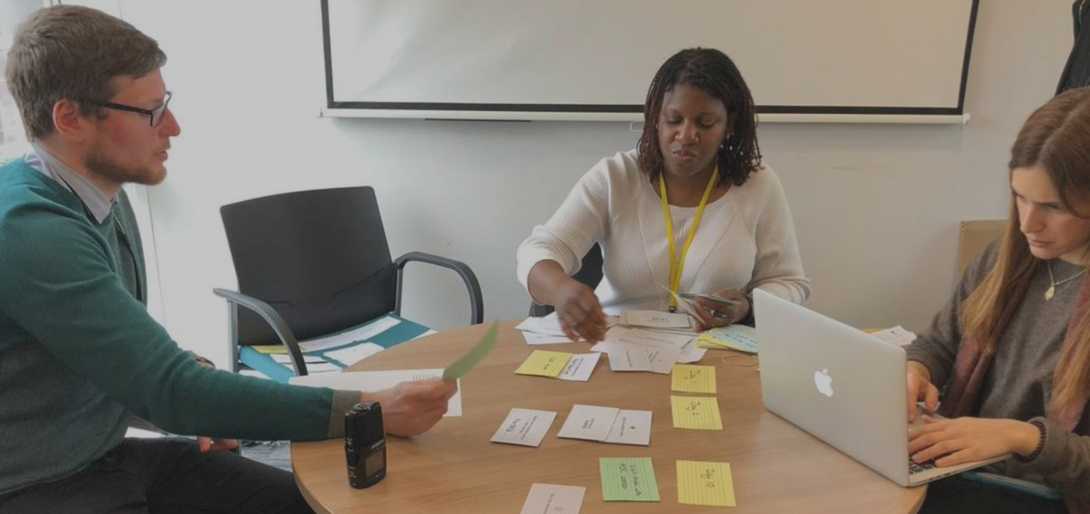
The objectives of alpha user research
The objectives of user research in the alpha phase were:
To understand social workers’ needs during the assessment process
To test different design concepts and features
To assess social workers’ experience with a prototype

Slide 12
alpha Overview in numbers
3
LOCAL AUTHORITIES PARTICPATED IN USER RESEARCH
23
AREA SOCIAL WORKERS PARTICIPATED IN USER RESEARCH
13
DIFFERENT SERVICES PROVIDED ACCESS TO DATA AND SYSTEMS
16
WEEKS ITERATING AND REFINING THE PROTOTYPE TO PRODUCE THE MINIMUM VIABLE PRODUCT
4
PROTOTYPES TESTED ACROSS SIMULATED AND ‘REAL’ SITUATIONS
5
CHILDREN AND FAMILIES SUPPORTED USING THE PROTOTYPES AS PART OF ‘LIVE’ TESTING
~3hr
OF TIME SAVED PER ASSESSMENT THAT CAN NOW BE SPENT WITH FAMILIES
~60%
OF SOCIAL WORKERS WOULD RECOMMEND FAMILY CONTEXT TO PEERS AND SUPPORT ITS ROLL-OUT

Slide 13
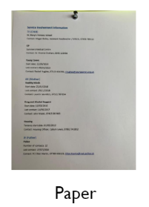
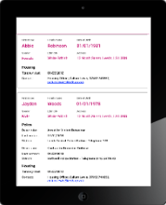
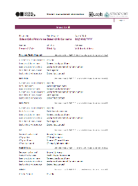
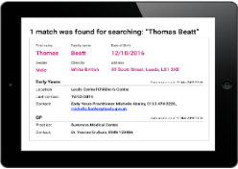
Alpha user research
In alpha, we undertook 4 rounds of user research across Leeds and Stockport using different prototypes and types of cases: from synthetic cases to real cases.
Prototype: Paper
Data: synthetic cases
Prototype: Digital
Data: synthetic cases
Prototype: Digital
Data: synthetic cases
Prototype: Excel*
Data: real cases
*Excel was used in the last round of user research to support live testing of the tool. In this, we observed 5 area social workers receiving referrals and using the Family Context prototype to identify relevant family members and services involved.

Slide 14
What the alpha users said
“
“
“
“We would know whom to contact right away and that person would know a lot about [the] family”
It is useful to have a breakdown of which service is linked to the family
“I can triangulate information to better understand what is going on…”
”
”
”
“
“Having the history there makes me think there is an issue with domestic violence, whereas without it I’d get there less quickly”
“
“
“I would definitely call [an] Adult Social Care practitioner if I had the contact details”
“It is useful to know when [information] was last updated”
”
”
”

Slide 15
Overall findings from alpha
Alpha
Findings
From testing the prototypes, we identified:
The shortlist of four services to include in the MVP*
The minimum set of data fields required for each service in order to provide value to social workers
The value that this minimum set of data fields brings for each service in comparison to what information social workers currently have
*In a prioritisation exercise with the local authorities, we ranked 12 services according to the value they bring to social workers, and how technically feasible their information would be to access for the tool. From this, Adult Social Care, Housing, Police and School were selected.

Slide 16


Validation of the alpha findings
WITH LOCAL AUTHORITIES FROM AROUND THE COUNTRY
In the alpha extension, we sought to validate our findings. We conducted user research with two other local authorities - North Somerset and Bracknell Forest – taking the total to five.

Slide 17
Validation of the alpha findings
WITH RESIDENTS WHO’VE EXPERIENCED CHILDREN SOCIAL CARE
We also conducted user research with residents who have previously experienced children’s social care. We wanted to ensure that we were also capturing their voice.
We heard from the residents that:
They understood the benefits of social workers having access to their information because “it can help them help [us].”
They felt information accessible to social workers should not be limited to children because “it is adult[s] that [are] the risk to the child.”
They believed sharing information at this level was proportionate because social workers “need to protect children.”

Slide 18




The outcome of alpha
By the end of alpha, we had confirmed the appropriate level of information for each of the 4 services that would be included in the MVP of the tool:
Adult Social Care
Housing
Police
School
The key next step was to identify a design pattern that would enable
Family Context to scale across multiple local authorities.

Slide 19
Overview of private beta user research

Slide 20
Briefing - Terms for understanding social workers’ practice
Term | Definition
Referral | When someone contacts Children’s Services to raise a concern over the wellbeing of a child, that contact is recorded and triaged. One possible outcome of the triage is a referral for social work assessment. You will find mock referrals on our private beta GitHub repository.
Children’s social work assessment | Assessments are carried out by social workers to identify the needs of a child and to ensure that families are appropriately supported to meet them.
Case Management System | Social workers use Case Management Systems to collect information on the children and families they support. For example, by recording the case notes from phone calls and visits. Most Case Management Systems have a relationships function, where social workers can link relevant individuals to a child. This helps them to build up a general picture of family relationships. The Children’s Services department in Leeds use Mosaic as their Case Management System; whereas, Stockport use LiquidLogic.

Slide 21
The Objectives of beta User research
There were two main objectives:
We wanted to explore questions such as:
Which user journey is most aligned to social workers’ current practice model, in terms of how they conduct assessments and use the Case Management System?
How clear and well understood is the information that is presented in the tool?
How easy is the tool to navigate for social workers?
1.
Understand which user journey of the Family Context tool is preferred by social workers
Test the usability of the local authority’s preferred user journey using a prototype
2.

Slide 22
The user journeys
For the MVP, we identified the 2 simplest potential user journeys, which deliver the service involvement information.
Search for any individual¹
Select an individual²
View an individual’s service involvement
This journey is repeated for any additional, relevant individuals that social workers want to search for
User journey 1
Login
Search for a child¹
Select a child²
View a child’s detail page with linked individuals³
View a linked individual’s service involvement
User journey 2
1. In each option, searching can be done by: (i) name; (ii) Case Management System ID; or (iii) a combination of the two.
2. Selection does not take place when a search is made using a Case Management System ID because this causes a direct match.
3. The list of suggested individuals in user journey 2 mirror those individuals that have been linked to the child in the Case Management System.

Slide 23
The need for two user journeys
We developed two user journeys for Family Context to respect and adapt to key differences in terms of:
Children’s Social Care practice (e.g. the practice model and how social workers engage with families)
Technical infrastructure (e.g. the technologies used, including the Case Management System)
Availability of data (e.g. the information social workers record)
The decision on which user journey to implement would be left to each local authority, to leverage their knowledge about what would be most suited to their environment. We believe that Family Context’s ability to adapt to different local authorities will enable it to scale.
It was clear that a ‘one size fits all’ user journey would inhibit scaling; whereas, offering alternatives would allow for the potential of the Family Context tool to be adopted more widely.

Slide 24
Beta user research timeline
Design Sprint
Round 1
Round 2
Ongoing
Two-week design sprint, which culminated in the development of two prototypes to test different user journeys
Focus on 1st objective: identifying the preferred user journey
Stockport: November 2019
Leeds: December 2019
Focus on 2nd objective: testing the usability of preferred user journey
Stockport: December 2019
Leeds: January 2020
Live testing of the tool
Key decision point: Local authorities decided which user journey of the Family Context tool was most appropriate to implement, based on their social worker preference as well as technical infrastructure and availability of data.

Slide 25
The methodology
1. Collect qualitative data through interviews
2. Synthesise the information from the interview scripts
3. Discuss key insights and iterate the prototype accordingly
We followed a three step process to ensure each round of user research was as thorough as possible.

Slide 26
The interviews
Over the course of private beta, we conducted 22 semi-structured interviews.
The interview process
Each interview was 45 minutes to 60 minutes long
All interviews were done in person (except two) to better observe participants’ behaviour
The interviews were conducted with social workers on an individual basis to ensure detailed and independent responses from all interviewees
Two interviewers were always present (one to facilitate and one to take verbatim notes)
The interview content
Contextual questions to understand a social worker’s role, their day-to-day work, and general experience of the assessment process
Targeted questions around a particular area of social workers’ practice to gain a more in-depth understanding of that area
Testing the usability of a prototype alongside a mock referral
For resources which allow you to run user research aimed at preparing to implement Family Context, please see the Family Context Overview and Implementation Guide (section 3.7) on our private beta GitHub repository.

Slide 27
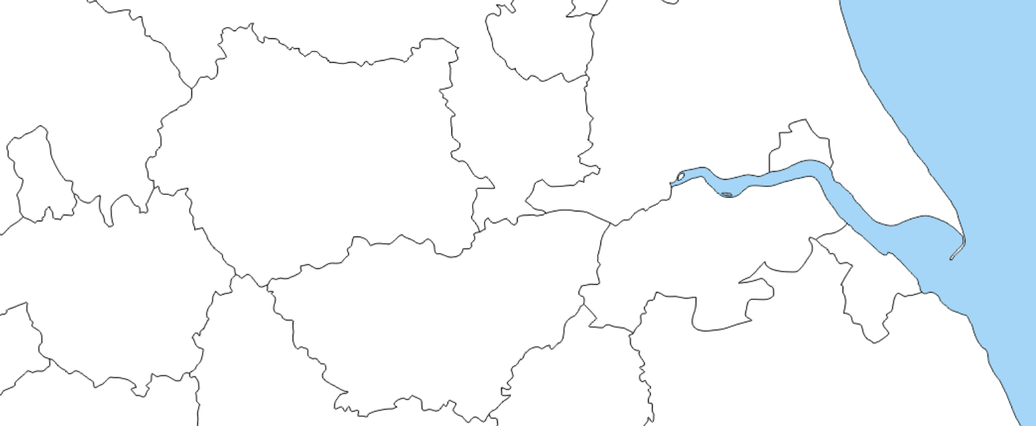
Identifying CORE USER GROUP: The beta locality teams
Social workers were identified in alpha as the core user of the Family Context tool.
For private beta, each local authority assigned a locality team to test and roll out the pilot.
Hough Lane,
Bramley, Leeds
WEST YORKSHIRE
GREATER
MANCHESTER
Werneth, Stockport
Social workers were identified as the core user due to their frequent and direct engagement with families that have a wide range of different needs. Other users (including specialist social workers, front door social workers and team managers) remain potential users to be considered in future developments of the tool.

Slide 28




Selecting the users for beta user research
A sample of social workers were chosen from each locality team. To ensure our sample was as representative as possible, we considered:
Age
The social workers we worked with were aged between X and X
Gender
We spoke to a mix of female and male social workers
Children’s Social Care work experience
The social workers were at different stages of their career, ranging from X-X years of experience.
Technical
proficiency
The level of technical capability varied significantly between the social workers.
Owing to Covid-19, we have not yet been able to confirm these figures. They will be updated as soon as possible.

Slide 29


The users for beta user research
Hough Lane, Bramley, Leeds
We conducted 11 interviews with 9 different social workers, including 4 senior social workers
Werneth, Stockport
We conducted 11 interviews with 6 different social workers, including X senior social workers
Owing to Covid-19, we have not yet been able to confirm these figures. They will be updated as soon as possible.

Slide 30
Private Beta User Research Findings:
Objective 1 - Identifying social workers’ preferred user journey

Slide 31
Background into round 1 (r1) of beta user research
A guided decision-making process helped local authorities determine the most suitable user journey for their context. Social workers’ perspective was one of three factors in this decision:
Service
Which user journey do Children’s Services and social workers feel is most aligned to their current practice model?
Technology
What is technically feasible considering the local data management infrastructure?
More information about the process for considering information governance and technology can be found in the Family Context Overview and Implementation Guide (section 3.8) on our private beta GitHub repository.
Information
Governance
Which user journey suits the data owners’ policies around data sharing?

Slide 32


Login
Search
Select
Detail page
Leeds r1 findings - user journey 1
Learning
Direct quotation
It is not in social workers’ mindsets to carry out searches on adults, and they felt that they didn’t have enough information to do so
“I’m not sure how much information we would hold about parents”
“Usually we don’t record on adults”
“Wouldn’t be able to identify the current individual if they hadn’t been linked on Mosaic”
*
Social workers had concerns regarding the openness of this user journey
“Difficult because there is the consent issue”
“I would ask for their consent first before using the tool”
*
*percentage of social workers
Conclusion: Social workers did not think that user journey 1 aligned to their practice model and how they work

Slide 33
Login
Search child
Select child
Child detail page w/ links
Detail page of linked person
Leeds r1 findings - user journey 2
Learning
Direct quotation
Social workers, Front Door and admin staff consistently use the CMS to link relevant individuals to the children on their caseload
“Relationships is also something that should be done on duty and advice”
“I can link relationships, but admin will help”
“In lots of other teams, it is probably expected for the social worker to do it [link relationships]”
*
It is useful for social workers to see information on the linked individuals (e.g. parents, siblings, etc.)
“Very useful to build up a picture”
“More of a chance to build a network and locate these people”
“It gives you routes to go down”
*
*percentage of social workers
Conclusion: Social workers felt that it was beneficial to see the relationships that they link in the CMS in user journey 2

Slide 34
Leeds r1 findings - How Social workers like to perform a search
Learning
Direct quotation
Social workers always searched for the child first
“Always search for the child first and work our way out”
*
More social workers preferred to search by name, but they recognised it was up to individual preference
“Will normally put in the name into Mosaic”
“Case IDs are normally long, and you have to copy + paste”
“If it couldn’t find it by name, I would use case ID”
*
*percentage of social workers
Conclusion: Social workers did not have a definite preference on how to perform a search

Slide 35
LEEDS Social workers’ preferred user journey
Social workers in Leeds preferred the second user journey showing linked relationships.
Login
Search for a child
Select a child
View a child’s detail page with linked individuals
View a linked individual’s service involvement
From the first round of user research we concluded:
Social workers did not think that user journey 1 aligned to their practice model and how they work
Social workers felt that it was beneficial to see the relationships that they link in the CMS in user journey 2
Social workers did not have a definite preference on how to perform a search
These findings were supported by the technology team, who confirmed that the quality of data captured on relationships is good enough to use in the tool; and by Information Governance, who were more comfortable with a closed search.

Slide 36
Login
Search
Select
Detail page
stockport r1 findings - user journey 1
Learning
Direct quotation
Social workers felt that it was valuable to be able to search for any individual
“It is valuable being able to search for a person if you have enough information about the person to search”
“It makes it very simple to access information”
“Sometimes you might need that information straight away”
*
Social workers did have a few concerns about the openness of this user journey
“[It] would have to be managed to make sure you search for the relevant and appropriate people”
*
*percentage of social workers
Conclusion: Social workers thought that the ability to search for any individual in user journey 1 was both valuable and necessary

Slide 37
Login
Search child
Select child
Child detail page w/ links
Detail page of linked person
stockport r1 findings - user journey 2
Learning
Direct quotation
Social workers do not use the linking relationship function consistently in their Case Management System for different reasons
“It is done patchily”
“I used to do a lot of linking in the previous system, don’t feel so comfortable doing it in LiquidLogic”
“One challenge is adding people without DOB and address”
*
Social workers felt they couldn’t rely on key individuals within a family being linked to a child
“Number of people linked by MASH is random. Sometimes serious cases don’t have a lot of people linked… Dad is very often an important individual missing in the picture”
*
Social workers felt that a delay of 24hrs to see newly linked individuals could impair their work**
“It depends on the case but generally waiting 24hrs is not worth it because I could find out the information myself”
*
*percentage of social workers
**there may be up to a 24hr delay, from the point an individual is linked to a child in the Case Management System to appearing in the tool
Conclusion: Social workers recognised that the lack of linked relationships in the CMS did not support user journey 2

Slide 38
stockport r1 findings - How Social workers like to perform a search
Learning
Direct quotation
Social workers always searched for the child first
“You search for the child first and work outwards - this would be the same in all cases and on all systems”
*
Half of the social workers preferred to search by case ID, but they recognised it was up to individual preference
“Easiest would be to put in case ID if [I] know it”
*
*percentage of social workers
Conclusion: Social workers did not have a definite preference on how to perform a search

Slide 39
STOCKPORT Social workers’ preferred user journey
Social workers in Stockport preferred the first user journey allowing them to search for individuals they consider relevant to the case, even if those individuals are not linked on the CMS.
Login
Search for any individual
Select an individual
View an individual’s service involvement
From the first round of user research we concluded:
Social workers thought that the ability to search for any individual in user journey 1 was both valuable and necessary
Social workers recognised that the lack of linked relationships in the CMS did not support user journey 2
Social workers did not have a definite preference on how to perform a search
These findings were supported by the technology team, who confirmed that the quality of data captured on relationships in LiquidLogic is low and insufficient to use in the tool; and by Information Governance, who co-developed the audit functionality and guidance around appropriate usage of the tool.

Slide 40
Private Beta User Research Findings:
Objective 2 - testing the usability of EACH local authority’s preferred user journey

Slide 41
background into round 2 of beta user research
The Family Context tool is made up of a number of different components. These components are re-used in slightly different ways to support alternative end-to-end user journeys.
The usability of these components was tested in the second round of beta user research through each local authority’s preferred user journey.
User Journey Type | Component
 | Logging in | Searching by name and inputting ID | Selecting¹ | Viewing basic details | Viewing suggested individuals | Viewing service information
User Journey1 | ✓ | ✓ | (✓) ¹ | ✓ |  | ✓
User Journey 2 | ✓ | ✓ | (✓) ¹ | ✓ | ✓ | ✓
¹Selection does not take place when a search is made using a Case Management System ID because this results in a direct match.

Slide 42
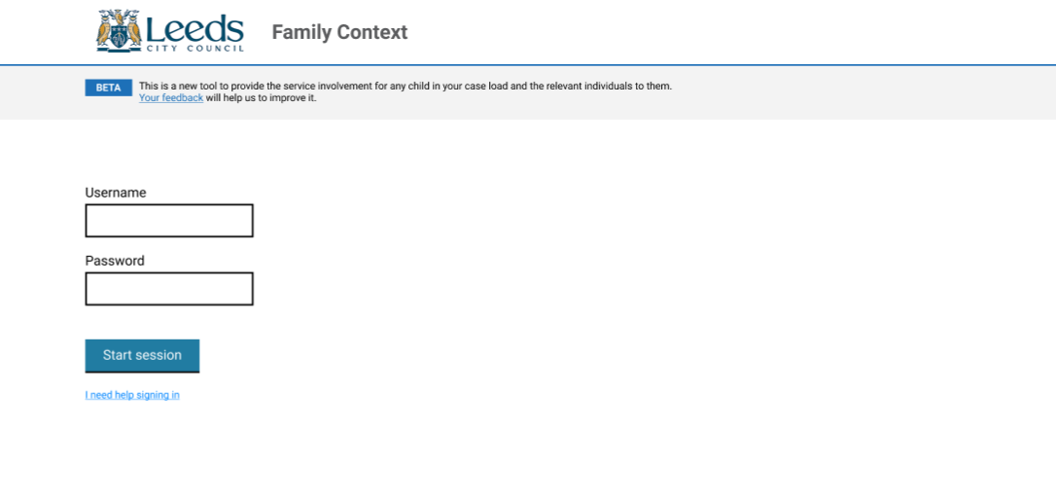
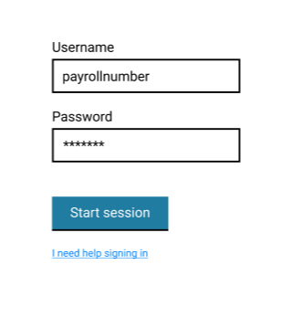
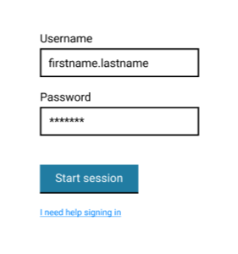
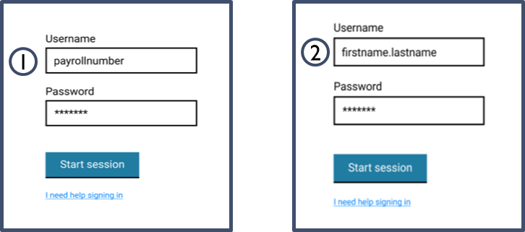
Research into the components: Logging in
Initial prototype tested
LA | Finding | Action
Leeds Stockport | It was validated that it is clear from the prototype how to login and start a session | No change
Leeds Stockport | There was a strong preference for having the same login details as their CMS | Change username to payroll number for Leeds Change username to firstname.lastname for Stockport
1
1
2
2
Updated MVP

Slide 43
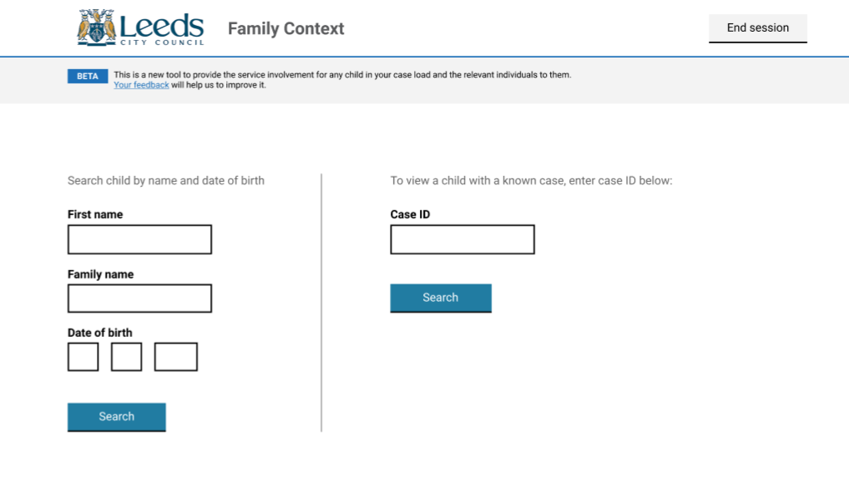
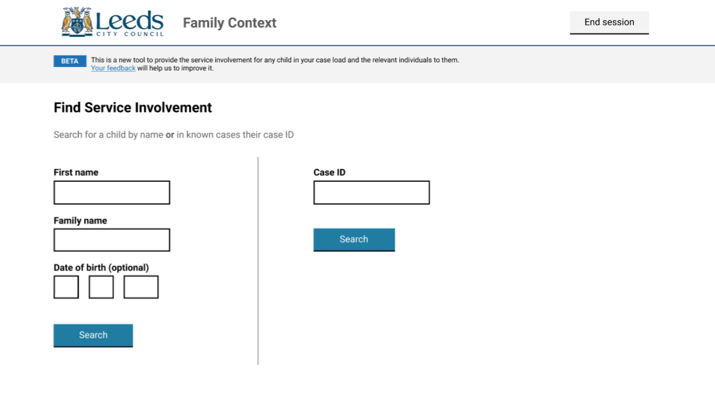
Research into the components: Searching by name and Inputting id
LA | Finding | Action
Leeds Stockport | Social workers do not always know an individual’s DOB | Make date of birth an optional search field
Leeds Stockport | The terminology ‘case ID’ was well understood | No change
Leeds Stockport | It is up to individual social worker’s preference to search either by name or ID, and this varied a lot within each team | Keep both options to search by name or CMS ID available
Leeds | It was unclear to social workers that they could choose between searching by name or CMS ID – they thought it was necessary to do both | Changed the wording of the descriptor at the top
Initial prototype tested
1
2
Updated MVP
3
3
2
1

Slide 44
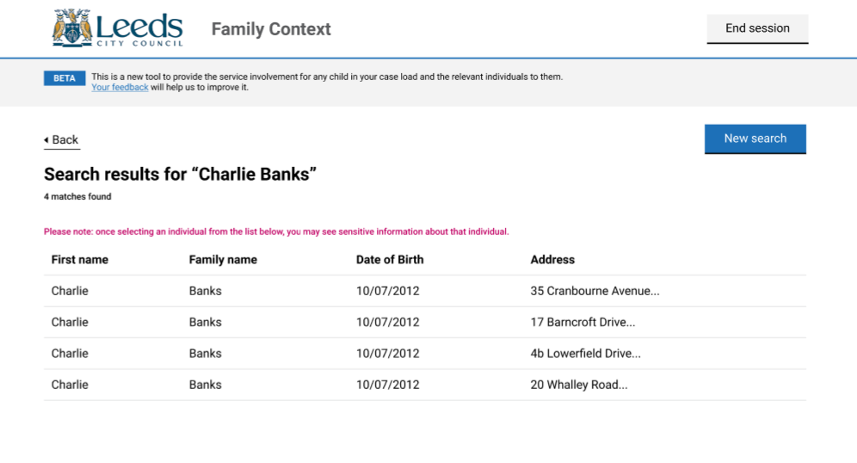
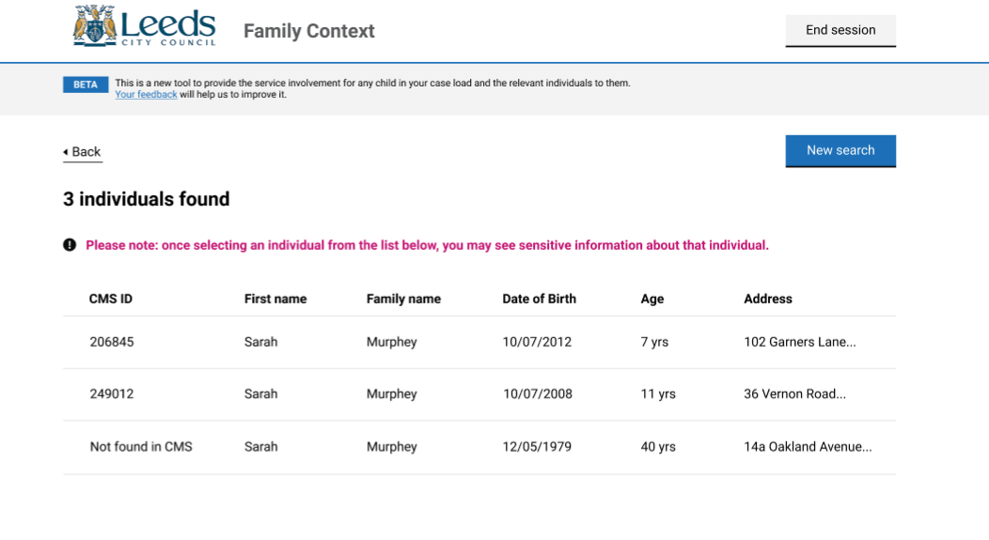
Research into the components: Selecting
Initial prototype tested
LA | Finding | Action
Leeds Stockport | It was validated that DOB and address were the most important fields to select the correct individual | No change
Leeds Stockport | Social workers felt that it was useful to see an individual’s CMS ID. This is helpful, for example, when DOB was the same as there was uncertainty if the results were showing different individuals or the same individual multiple times | CMS ID added
Stockport | It was unclear what NA meant when an individual’s CMS ID was missing | Wording changed from ‘NA’ to ‘Not found in –’
Stockport | Social workers use DOB to calculate the age, when they are unsure who the correct individual is | Age added
Leeds Stockport | It is helpful to order results by age/DOB | Results ordered to show the youngest first
1
Updated MVP
2
3
1
3
4
2
4

Slide 45
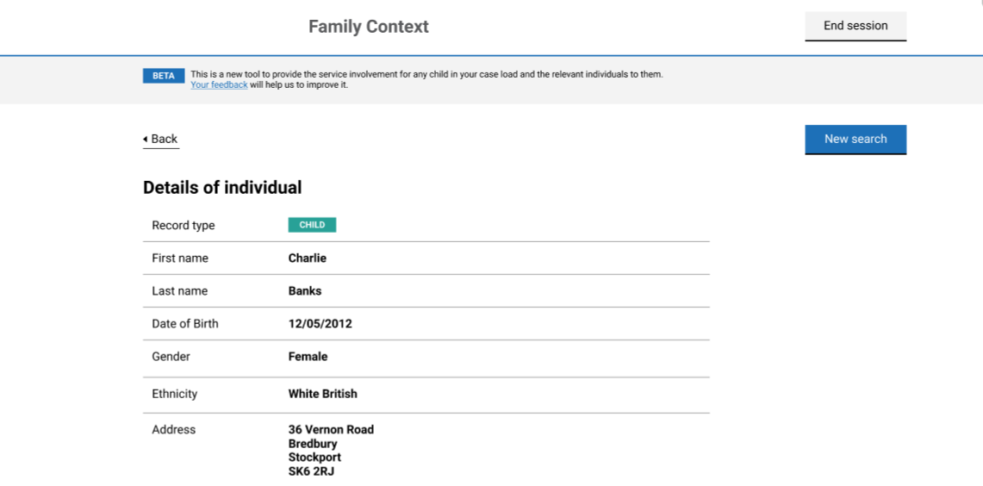
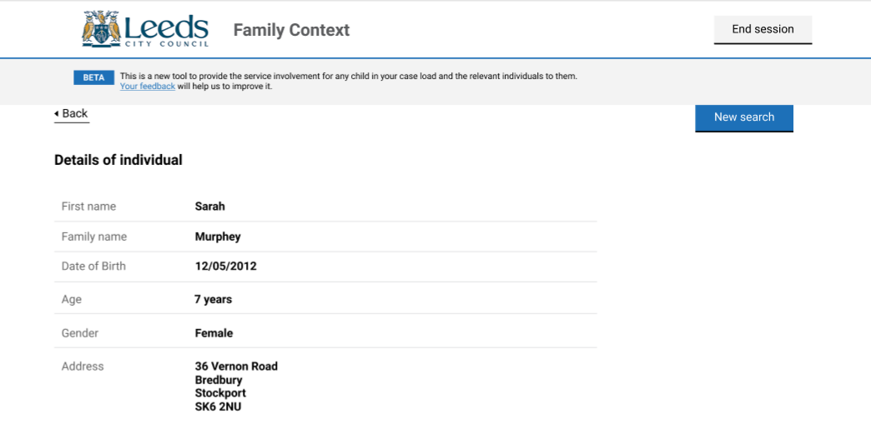
Research into the components: viewing basic details
LA | Finding | Action
Leeds Stockport | Social workers use the basic information for cross checking between individuals | No change
Stockport | Social workers did not feel that ethnicity was a necessary field | Ethnicity taken out
Leeds Stockport | It is useful to social workers to show the age of an individual | Age added
Initial prototype tested
Find original
1
Updated MVP
1

Slide 46
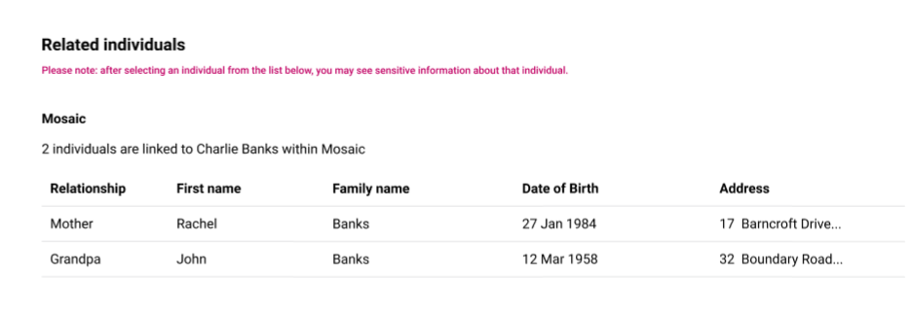
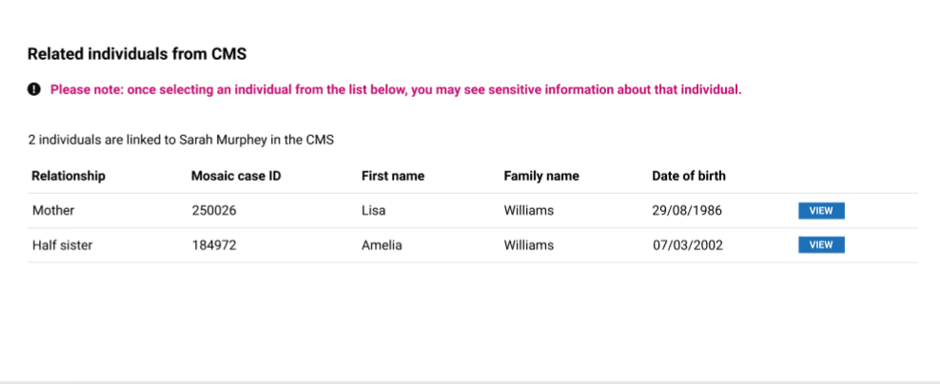
Research into the components: viewing suggested individuals
Initial prototype tested
LA | Finding | Action
Leeds | It was validated that it is useful to see the relationship of an individual to a child | No change
Leeds | It was unclear that it is possible to click into the individuals listed to view that service information | Added in ‘view’ button
1
Updated MVP
1

Slide 47
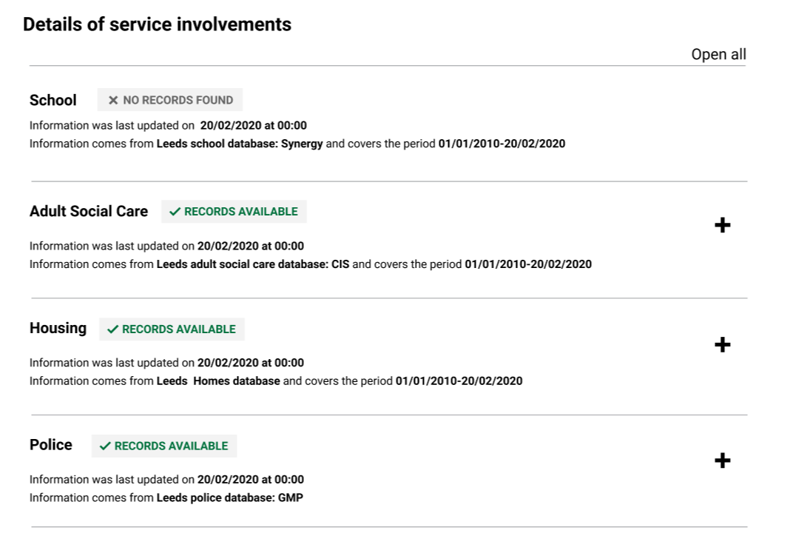
Research into the components: viewing service involvement flags
LA | Finding | Action
Leeds Stockport | It was validated that social workers could understand from the prototype which services held records for an individual | No change
Leeds Stockport | It was validated that social workers knew how to expand the information by clicking on the plus sign | No change
Leeds Stockport | Social workers did not recognise the names of all the databases e.g. CIS and Synergy | Change the wording of the label to state the service database and its name
Stockport | Some social workers were unclear on the meaning of the dates in the label | Changed the wording of the label to read ‘last updated on’ and ‘covers the period of’
Updated MVP
1
2
1
2

Slide 48
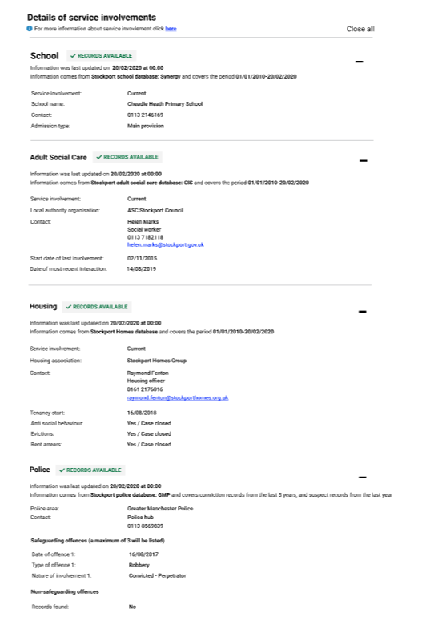
Research into the components: viewing service involvement details
LA | Finding | Action
Leeds Stockport | It was validated that social workers knew how to close the information by clicking on the minus sign | No change
Leeds | Social workers made the assumption that if an individual was not in a property listed under Leeds Home then they were not in a council owned property at all | Insert link/button to navigate to more information about the conditions for which service involvement is shown
Leeds Stockport | Social workers were unclear what ‘current’ meant in terms of Police service involvement | Remove ‘current’
Leeds Stockport | Social workers were unclear that a maximum of 3 safeguarding offences would be shown | Add in tag to say ‘a maximum of 3 will be listed’
Updated MVP
1
1
2
3
2
3

Slide 49
NExt Steps

Slide 50
Continuing user research in Leeds and Stockport (1/2)
The user research to date has been conducted on prototypes. Once the tool is launched in each locality, the user research will have a different focus. This includes:
1. Usability testing
In Leeds, a different technology (an SSRS report surfaced through PowerBI) is being used for the tool. Whilst it is closely aligned to the original designs, more usability testing is required to identify where there may be specific usability issues e.g. problems with the language or layout.
In Stockport, usability testing will be conducted to confirm that social workers can use the live tool with as much ease as the prototypes, identifying any amendments that need to be made.

Slide 51
Continuing user research in Leeds and Stockport (2/2)
2. Measuring the impact
In both local authorities, user research will be conducted to assess how social workers are using the tool alongside other systems. This will help us to evaluate the value of the tool in terms of: (i) its contribution to making social workers’ workflow more efficient and (ii) the impact it has on safeguarding children.
Any findings from the user research conducted on the live tool will feed into developing and improving the Family Context tool for future iterations.

Slide 52
Continuing user research more broadly
Further to that, our goal is to conduct targeted user research to test the tool with a wide range of councils. This will include rural and urban local authorities and those with differing densities of young people. Doing so will help us to improve the Family Context service and ensure that it works for all.

